Slide 1

CSCI 132: Basic Data Structures and Algorithms
Syllabus and Logistics
Reese Pearsall
Spring 2025
https://www.cs.montana.edu/pearsall/classes/spring2025/132/main.html

Slide 2
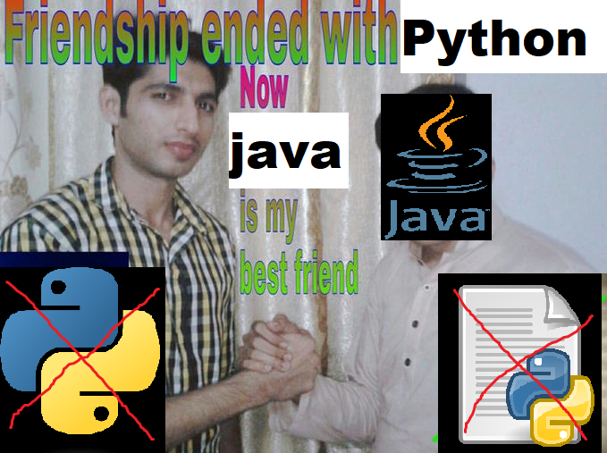
Our Goals for this Semester
Code (a lot)
Learn a new programming language (Java)

Slide 3
Our Goals for this Semester
Code (a lot)
Learn a new programming language (Java)
Explore the endless possibilities of
Object-Oriented Programming (OOP)

Slide 4
Our Goals for this Semester
Code (a lot)
Learn a new programming language (Java)
Explore the endless possibilities of
Object-Oriented Programming (OOP)
Learn a variety of Data Structures that we can use in our programs

Slide 5
Our Goals for this Semester
Code (a lot)
Learn a new programming language (Java)
Explore the endless possibilities of
Object-Oriented Programming (OOP)
Learn a variety of Data Structures that we can use in our programs
Learn a variety of algorithms for searching and sorting

Slide 6
Our Goals for this Semester
Code (a lot)
Learn a new programming language (Java)
Explore the endless possibilities of
Object-Oriented Programming (OOP)
Learn a variety of Data Structures that we can use in our programs
Learn a variety of algorithms for searching and sorting
Analyze the complexity and runtime of the algorithms that we write

Slide 7
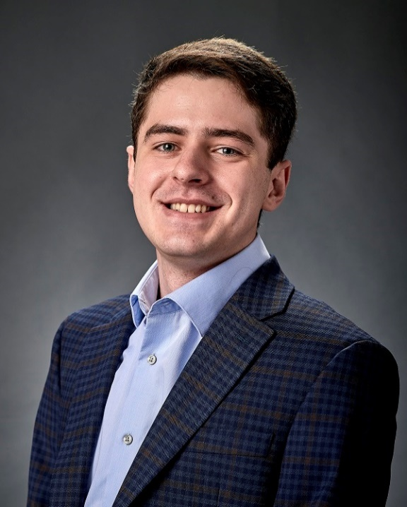
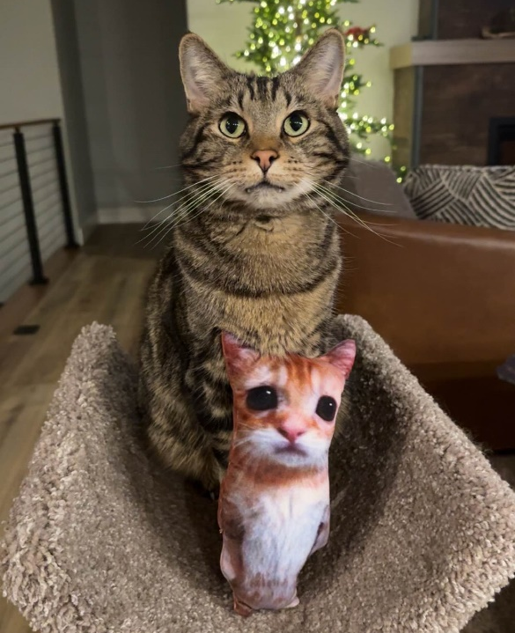

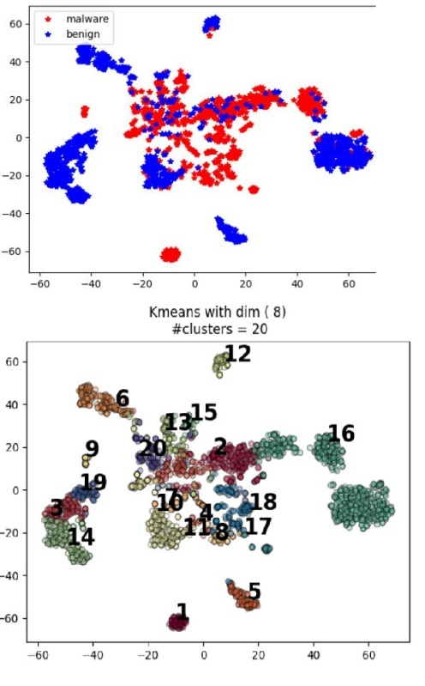
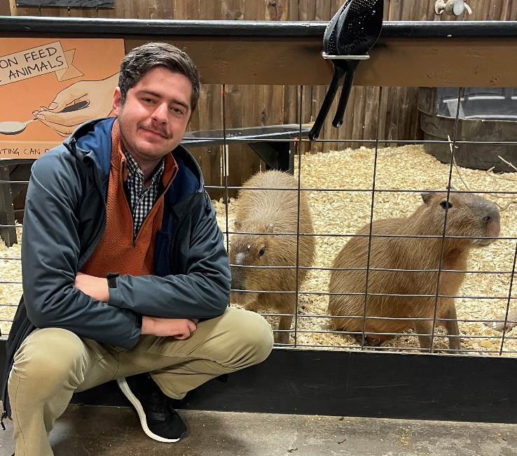
Reese Pearsall
(pierce-all)
Third year Instructor @MSU
B.S & M.S @ MSU
Hometown
Billings, MT
Interests
Cybersecurity
Malware analysis and detection
Cybercrime
Computer Science Education
Teaching
CSCI 132
CSCI 232 (Networks)
ESOF 422 (Cybersecurity)
Meatball
Favorite Breakfast Item
Breakfast Burrito
Experience
Software Engineer and Tester, Techlink (Bozeman)
Software Engineer, United States Air Force (Hill AFB, Utah)
Cybersecurity Software Engineer, Hoplite Industries (Bozeman)
Graduate Researcher, MSU (Bozeman)
Outside of academia
Video games, New England Patriots, Fantasy Football, TikTok (rip), Garfield, Dr Pepper, Memes, The Bachelor, Naps

Slide 8
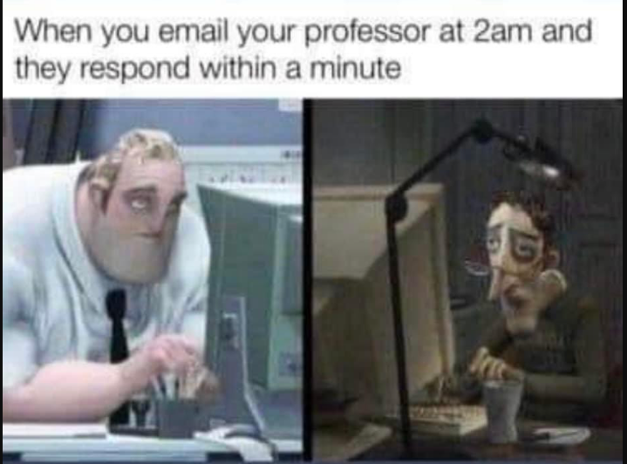
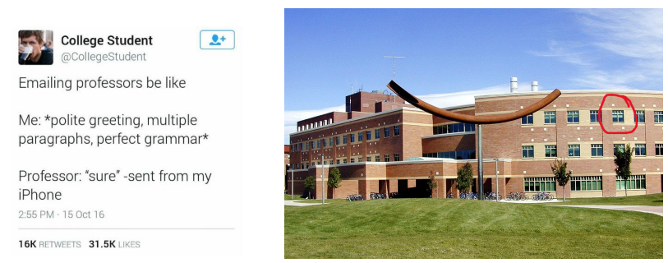
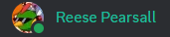
Contact
Email: reese.pearsall@montana.edu
Office Hours: Tuesday, Wednesday, Friday 12:00 PM – 1:00 PM
Office: Barnard Hall 361
Discord: @reese_p
(I am very responsive on Discord– you can always send me a DM)

Slide 9
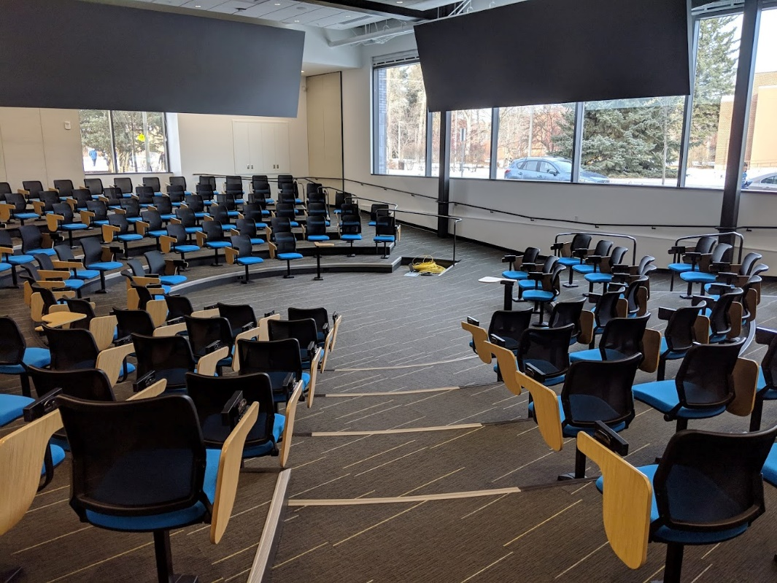
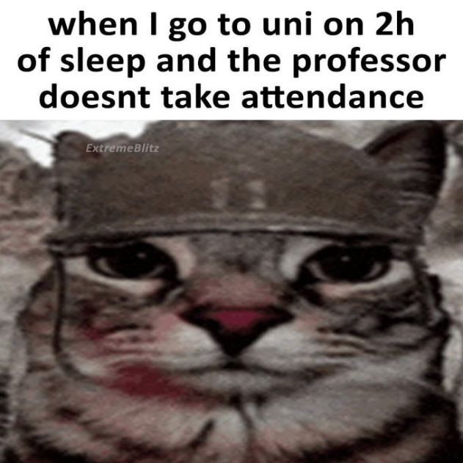
Course Logistics (Lecture)
Class Meetings
MWF: 3:10 – 4:00 PM
Norm Asbjornson Hall 165
All lectures will be recorded and posted on the course website
(coming to class is still a good idea)
We will be doing lots of live coding during lecture, so it might be helpful if you bring your own laptop to class (if you would like to code along)
Please be respectful and considerate of your classmates siting around you

Slide 10
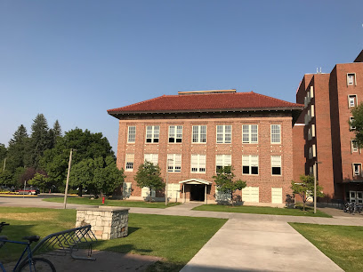

Course Logistics (Lab)
Section 003- Tuesdays 10:00 - 11:50 AM
Section 004- Tuesdays 12:00 - 2:00 PM
Section 005- Tuesdays 2:10 - 4:00 PM
Section 006- Tuesdays 4:10 - 6:00 PM
Locations: Roberts 111
You can go to lab and get help from your TA and lab assistants
Lab attendance is optional
Lab assignments will be posted a few days before Tuesdays and can be completed from home.
You can attend a different lab section earlier/later in the day if you would like

Slide 11
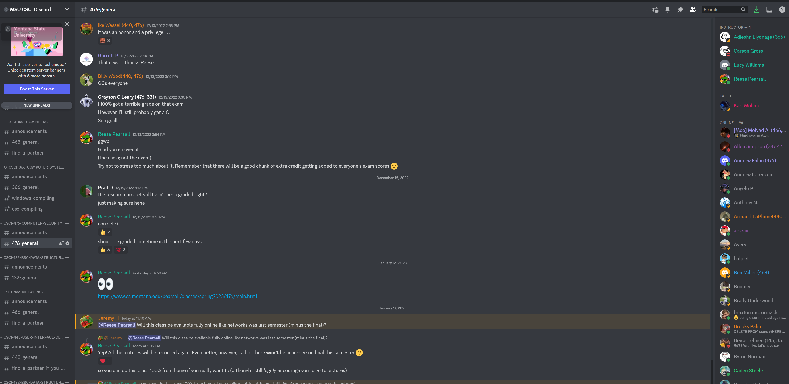
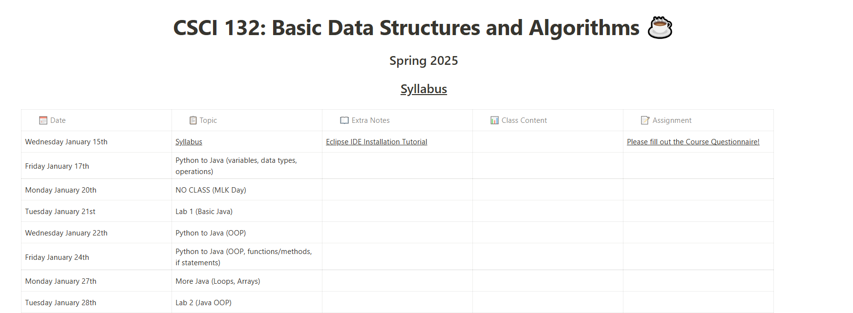
Course Logistics
You will be visiting this website a lot… be sure to bookmark it!
You also will need to join our Discord server!
https://www.cs.montana.edu/pearsall/classes/spring2025/132/main.html
Please set your Discord nickname to match your name

Slide 12
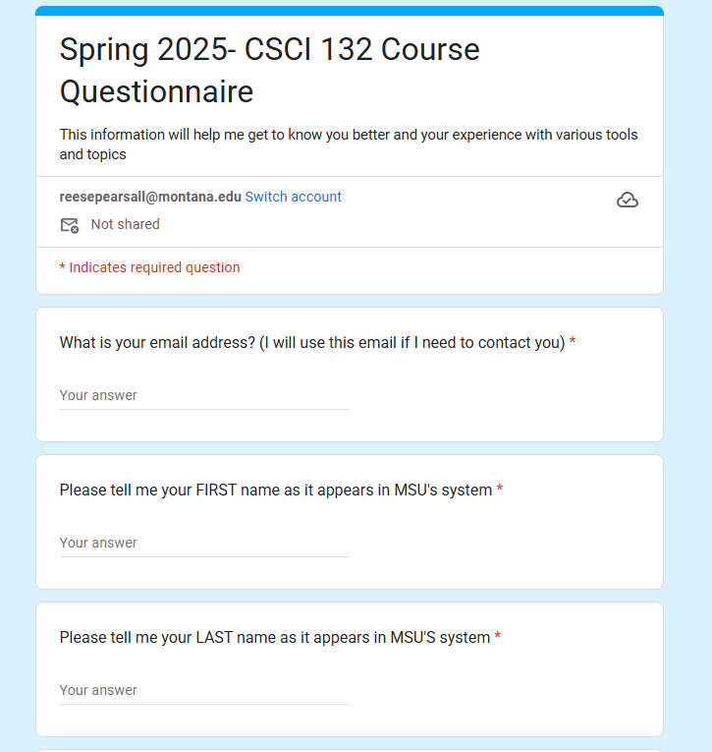
Course Questionnaire
Please take some time this week to fill out the course questionnaire ☺

Slide 13
Prerequisites
If you failed CSCI 127, you should not be here
CSCI 127- Joy and Beauty of Data
M151Q- Precalculus*
*(you will be fine if you have not completed M151Q)
You should feel comfortable with basic programming constructs:
(functions, variables, loops, if statements, lists, etc)

Slide 14
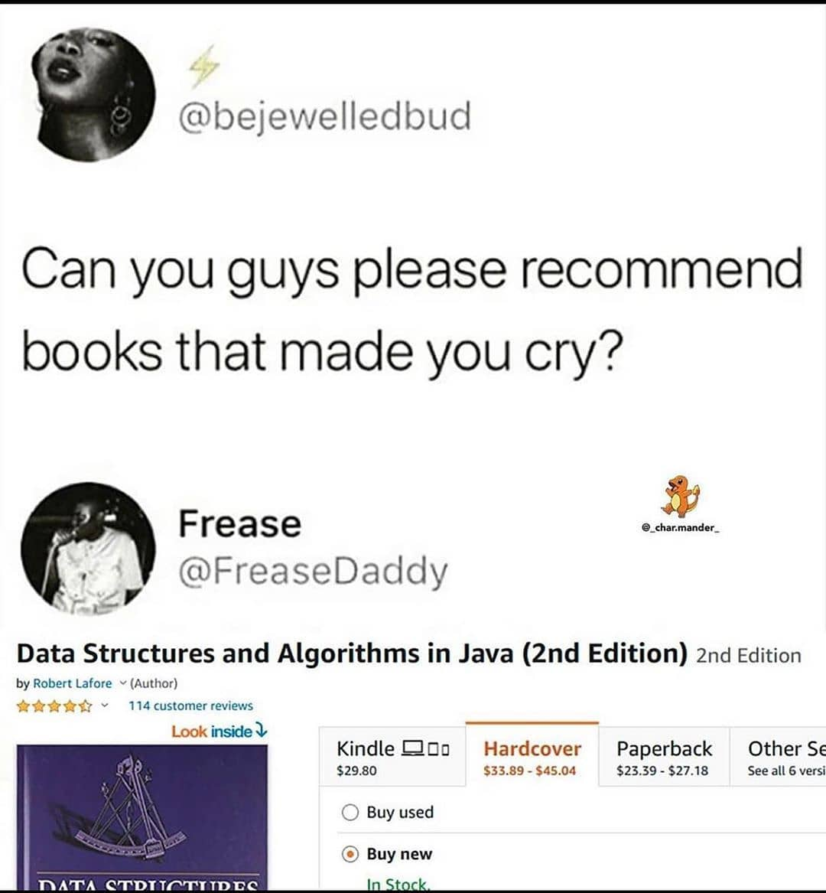
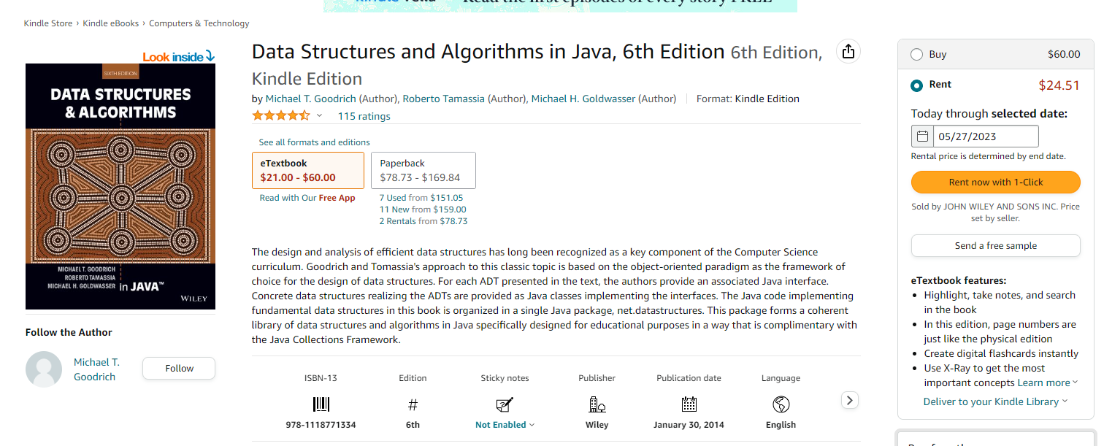
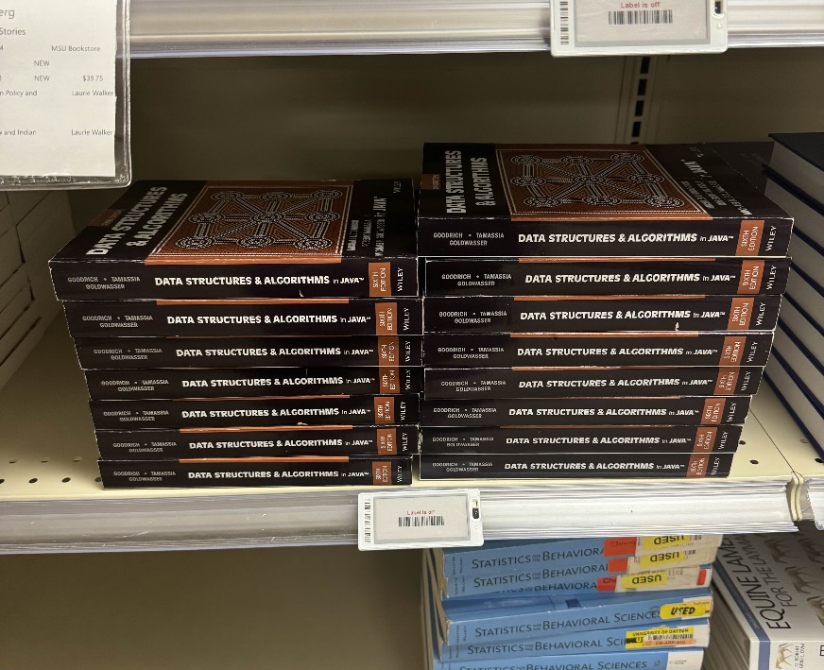
Textbook
Data Structures and Algorithms in Java, 6th Edition by Goodrich, Tamassia, and Goldwasser
unfortunately, a very relatable meme
This textbook is not required
(but it does have tons of great stuff!!)
It’s in the MSU bookstore

Slide 15
Grading
35% - Labs (12 @ ~3% each)
45% - Programs (5 @ 9% each)
10% - Midterm
10% - Final Exam

Slide 16
Grading
Labs (35%)
Shorter, weekly assignments.
Can generally be finished within 1-2.5 hours
Due on Tuesday nights @ 11:59 PM
You are given starting code
I will post the labs a few days ahead of time
You should be able to finish within your 2hr lab time
I will drop your lowest lab grade at the end of the semester
Individual submissions

Slide 17
Grading
Programs (45%)
Longer, more complicated programming assignments
Will likely take 2+ hours to complete
You will always have 2-3 weeks to complete them
Write from scratch (usually no starting code)
Much higher stakes, make sure you give yourself plenty of time to complete them
You can get help from your TA during lab time or office hours
You are allowed to work with 1 partner

Slide 18
Grading
Exams (Midterm and Final) (20%)
Midterm: Wednesday March 5th
Final: Monday May 5th
In-person
Exams consist of short answer, multiple choice, true/false, matching
I think both exams will be in the form of a D2L quiz and autograded

Slide 19

Grading
Extra Credit
Rubber Duck Extra Credit (1%)
I will give you a rubber duck to take care of during the semester (February 7th)
If you still have the rubber duck by the end of the semester, and if it is still alive, I will give you extra credit

Slide 20
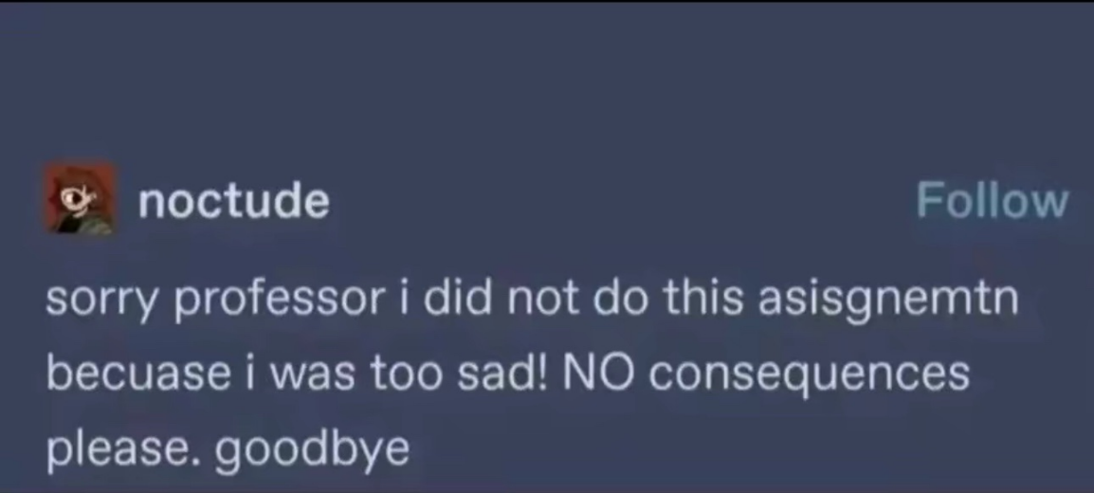
Late assignment policy
If you submit late, but you are within < 24 of the original deadline, you will face a -25% penalty
If you submit late, but you are within < 48 of the original deadline, you will face a -50% penalty
Any assignment submitted 48+ hours after the deadline will not be accepted

Slide 21
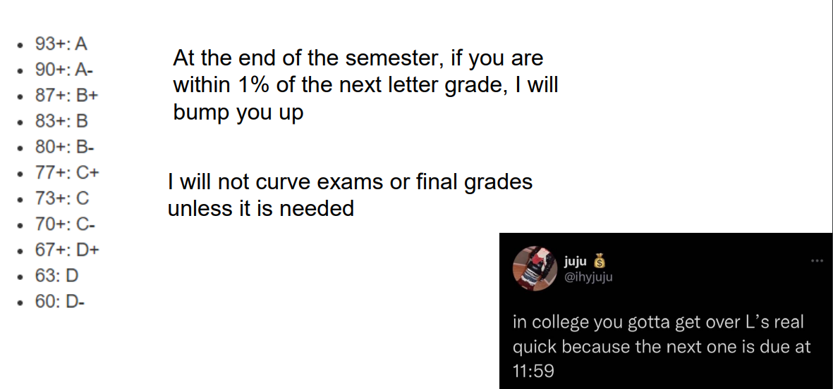
Grading Scale

Slide 22
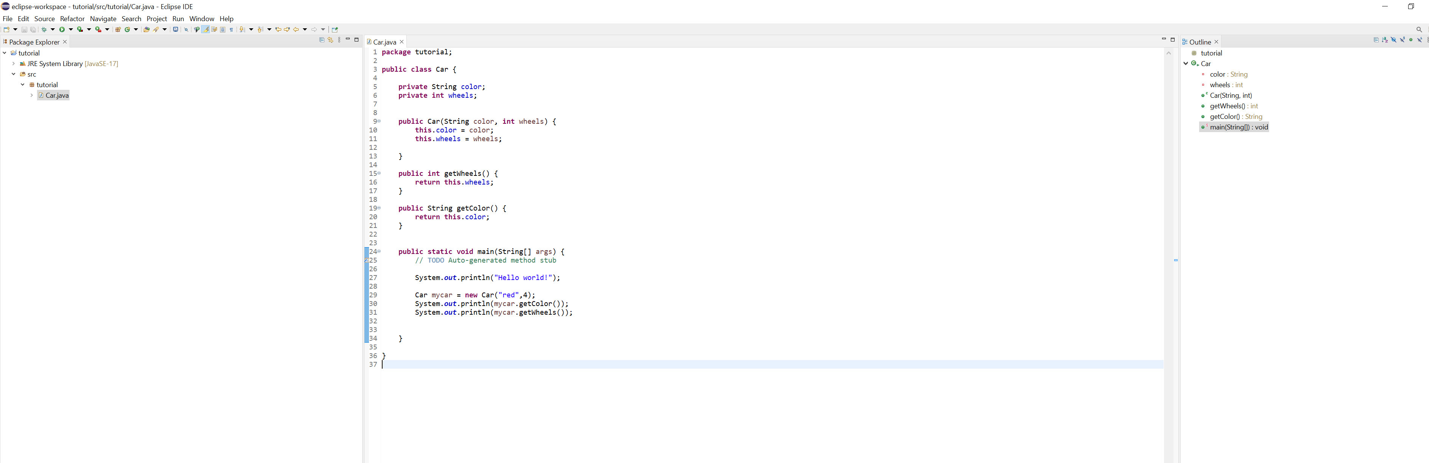
IDE
You will need to download an IDE that you can write Java programs in
Eclipse (I will use this one)
Netbeans
IntelliJ
I will post a video walking you through the installation process ☺

Slide 23
Academic Misconduct
Plagiarism and cheating is very not cool
You are not allowed to submit something that is not your own, and you are not allowed to steal solutions from another person and modify it
I have a Chegg and Course Hero membership. Don’t try it
Using small snippets of code from the internet is acceptable (but should not be needed). If you do use a small snippet of code from the internet, you should leave a reference as a comment in your code
Do not use any tools or AI that will write code for you

Slide 24
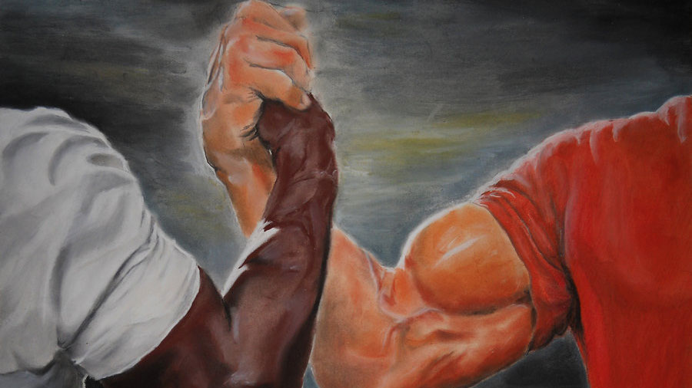
Collaboration Policy
All labs will be individual submissions.
For programs, you are allowed to work with one partner.
When it comes to labs, you may
Share ideas with other students in the class.
Work together on labs in the same physical location.
Help other students troubleshoot problems.
Give hints or provide textbook page numbers/slide numbers to students seeking help
You may NOT
Share your code and solutions directly with other students.
Submit solutions that you did not write.
Modify another student's solution and claim it as your own.
Share your report or solutions directly on Discord

Slide 25
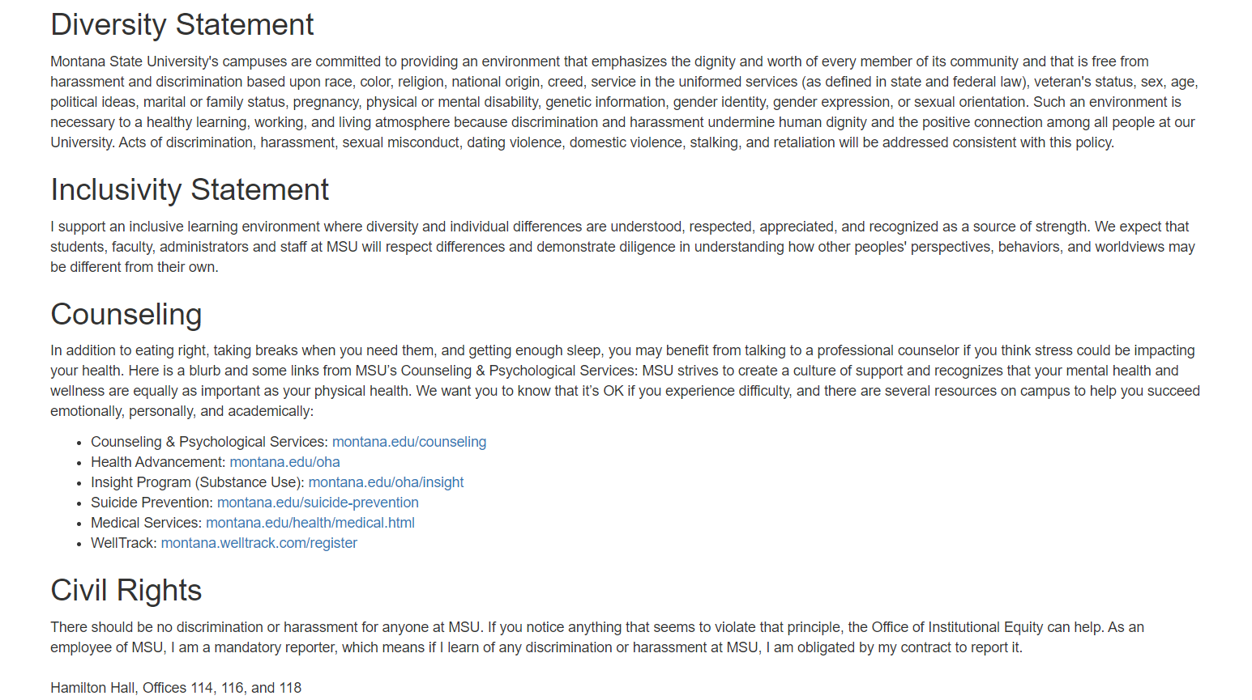
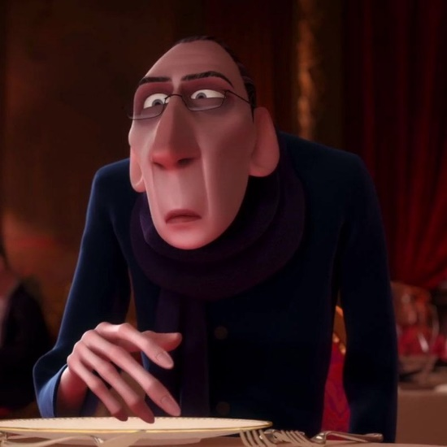
Additional MSU Resources:
https://www.cs.montana.edu/pearsall/classes/msu_resources.html
“Not everyone can become a great artist, but a great artist can come from anywhere”

Slide 26
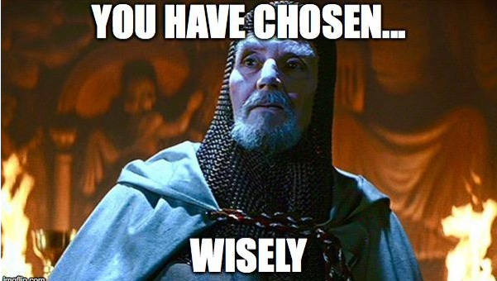
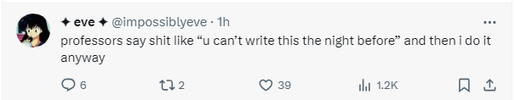
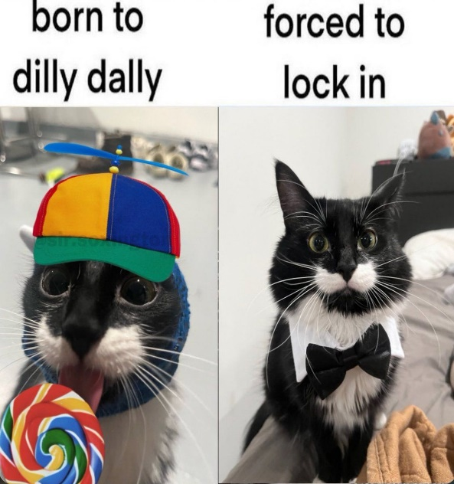

How to do well in this class
The first few weeks of this class move fast, and it can be easy to get behind.
Get help when you need it
Get started on assignments early (especially programs)!
Come to class and office hours
Take care of yourself

Slide 27
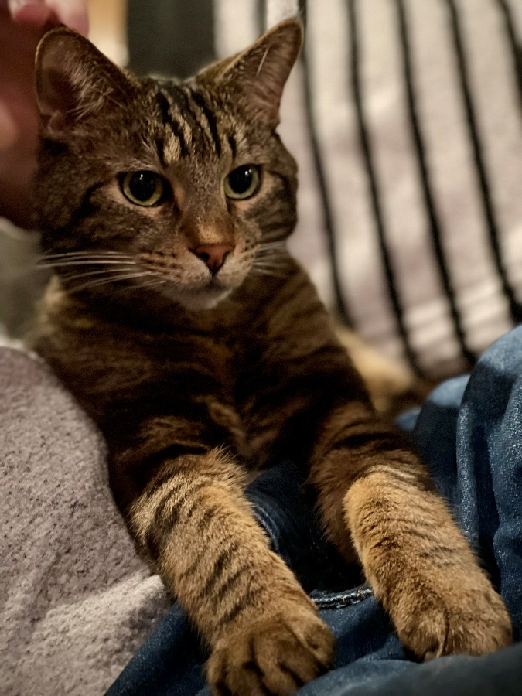
Questions?

